Slide 1
Data visualization using Matplotlib
Matplotlib is a plotting library for Python.
Conventionally, the package is imported into the Python script by adding the following statement −
from matplotlib import pyplot as plt
Here pyplot() is the most important function in matplotlib library, which is used to plot 2D data.

Slide 2
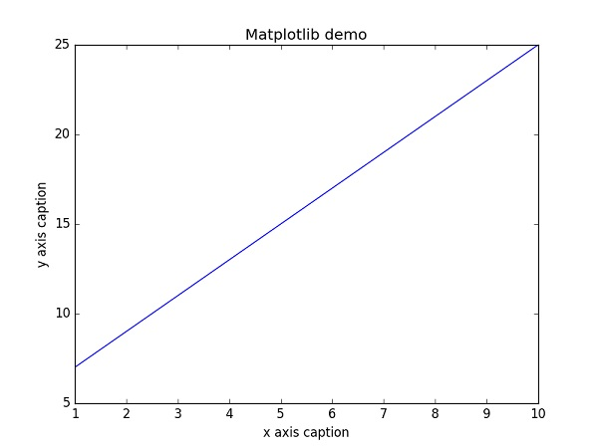
Example: Line Plot
Plot the equation y = 2x + 5
Program
import numpy as np
from matplotlib import pyplot as plt
x = np.arange(1,11)
y = 2 * x + 5
plt.title(“Line Plot")
plt.xlabel("x axis")
plt.ylabel("y axis”)
plt.plot(x,y)
plt.show()

Slide 3
Instead of the linear graph, the values can be displayed discretely by adding a format string to the plot() function.
‘-’: Solid line style
‘- -’: Dashed line style
‘-.’: Dash-dot line style
‘:’: Dotted line style
‘.’: Point marker
‘,’: Pixel marker
'o‘: Circle marker
'v‘: Triangle_down marker
'^‘: Triangle_up marker
'<‘: Triangle_left marker
'>‘:Triangle_right marker
's‘: Square marker
'p‘: Pentagon marker
'*‘: Star marker

Slide 4
The following color abbreviations are also defined.
Character | Color
'b' | Blue
'g' | Green
'r' | Red
'c' | Cyan
'm' | Magenta
'y' | Yellow
'k' | Black
'w' | White

Slide 5
Example
import numpy as np
from matplotlib import pyplot as plt
x = np.arange(1,11)
y = 2 * x + 5
plt.title(“Line Plot")
plt.xlabel("x axis caption")
plt.ylabel("y axis caption")
plt.plot(x,y,"ob")
plt.show()

Slide 6
Sine Wave Plot
import numpy as np
import matplotlib.pyplot as plt
# Compute the x and y coordinates for points on a sine curve
x = np.arange(0, 3 * np.pi, 0.1)
y = np.sin(x)
plt.title("sine wave form")
# Plot the points using matplotlib
plt.plot(x, y)
plt.show()

Slide 7
subplot()
The subplot() function allows you to plot different things in the same figure. In the following script, sine and cosine values are plotted.
Program:
import numpy as np
import matplotlib.pyplot as plt
# Compute the x and y coordinates for points on sine and cosine curves
x = np.arange(0, 3 * np.pi, 0.1)
y_sin = np.sin(x)
y_cos = np.cos(x)
# Set up a subplot grid that has height 2 and width 1,
# and set the first such subplot as active.
plt.subplot(2, 1, 1)
# Make the first plot
plt.plot(x, y_sin)
plt.title('Sine')
# Set the second subplot as active, and make the second plot.
plt.subplot(2, 1, 2)
plt.plot(x, y_cos)
plt.title('Cosine')
# Show the figure.
plt.show()

Slide 8
Horizontal subplot
import numpy as np
import matplotlib.pyplot as plt
t=np.arange(0.0,20.0,1)
s=[1,2,3,4,5,6,7,8,9,10,11,12,13,14,15,16,17,18,19,20]
plt.subplot(2,1,1)
plt.title("sublot 1")
plt.plot(t,s)
plt.subplot(2,1,2)
plt.title("sublot 2")
plt.plot(t,s,"r-")
plt.show()

Slide 9
Vertical subplot
import numpy as np
import matplotlib.pyplot as plt
t=np.arange(0.0,20.0,1)
s=[1,2,3,4,5,6,7,8,9,10,11,12,13,14,15,16,17,18,19,20]
plt.subplot(1,2,1)
plt.title("sublot 1")
plt.plot(t,s)
plt.subplot(1,2,2)
plt.title("sublot 2")
plt.plot(t,s,"r-")
plt.show()

Slide 10
Subplot grid
import numpy as np
import matplotlib.pyplot as plt
t=np.arange(0.0,20.0,1)
s=[1,2,3,4,5,6,7,8,9,10,11,12,13,14,15,16,17,18,19,20]
plt.subplot(2,2,1)
plt.title("sublot 1")
plt.plot(t,s)
plt.subplot(2,2,2)
plt.title("sublot 2")
plt.plot(t,s,"r-")
plt.subplot(2,2,3)
plt.title("sublot 2")
plt.plot(t,s,"g-")
plt.subplot(2,2,4)
plt.title("sublot 2")
plt.plot(t,s,"y-")
plt.show()

Slide 11
bar()
The pyplot submodule provides bar() function to generate bar graphs.
Program
from matplotlib import pyplot as plt
x = [“a”,”b”,”c”]
y = [12,16,6]
x2 = [6,9,11]
y2 = [6,15,7]
plt.bar(x, y, align = 'center')
plt.bar(x2, y2, color = 'g', align = 'center') plt.title('Bar graph')
plt.ylabel('Y axis')
plt.xlabel('X axis')
plt.show()

Slide 12
import matplotlib.pyplot as plt; plt.rcdefaults()
import numpy as np
import matplotlib.pyplot as plt
objects = ('Python', 'C++', 'Java', 'Perl', 'Scala', 'Lisp')
y_pos = np.arange(len(objects))
performance = [10,8,6,4,2,1]
plt.bar(y_pos, performance, align='center', alpha=0.5)
plt.xticks(y_pos, objects)
plt.ylabel('Usage')
plt.title('Programming language usage')
plt.show()

Slide 13
Histogram
NumPy has a numpy.histogram() function that is a graphical representation of the frequency distribution of data. Rectangles of equal horizontal size corresponding to class interval called bin and variable height corresponding to frequency.
Program
import numpy as np
a=np.array([22,87,5,43,56,73,55,54,11,20,51,5,79,31,27])
plt.hist(a, bins = [0,20,40,60,80,100])
plt.title("histogram")
plt.show()

Slide 14
Pie Chart
Pie charts are good to show proportional data of different categories and figures are usually in percentages.
Program
import matplotlib.pyplot as plt
province_population = [12344408, 2441523, 30523371, 110012442, 47886051] activities = ['Balochistan', 'Gilgit-Baltistan', 'Khyber Pakhtunkhwa', 'Punjab', 'Sindh']
plt.pie(province_population, labels=activities, startangle=90, autopct='%.1f%%') plt.title('Pakistan Population Province Wise') plt.show()

